Slide 1

Mental Health
2020 – 2022
Snapshot
Presented by:
Adam Raffel
Heidi Fox
Levi Fahring

Slide 2
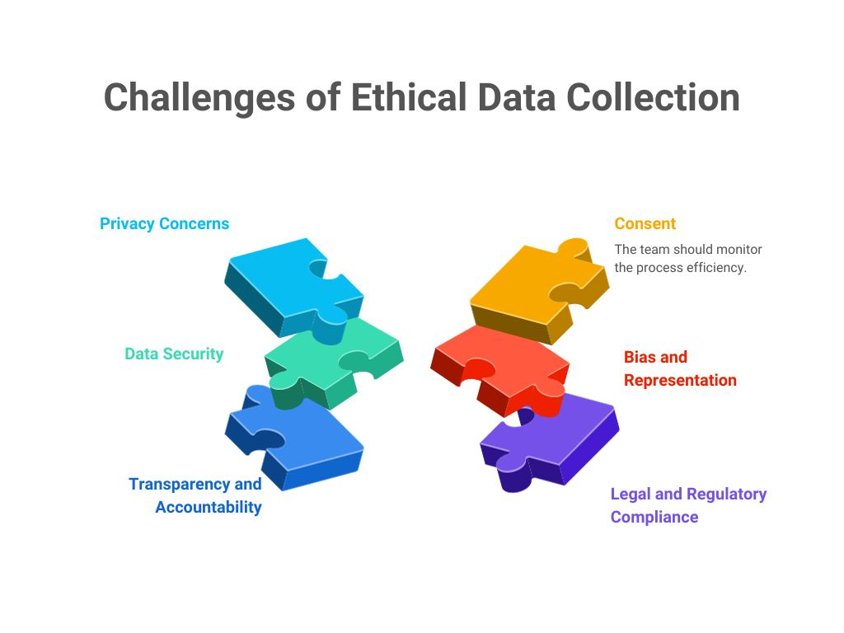
Ethical Consideration
When presenting a project about mental health and SUD, it is crucial to approach the topic with sensitivity and ethical responsibility. First and foremost, it's essential to prioritize the mental health and well-being of the audience by providing content that is informative yet respectful, avoiding sensationalism or graphic details that could trigger distress. Clear content warnings should be included to prepare viewers for potentially distressing topics. Additionally, it is important to ensure accuracy in the information presented, drawing from credible sources and research to avoid spreading misinformation. Lastly, fostering an open dialogue that encourages understanding and compassion can help create a supportive environment, allowing individuals to engage with the subject matter thoughtfully and empathetically.

Slide 3


Mental Health and Substance Use Disorders are important drivers for our community and community public health. The U.S. Department of Health and Human Services can use the information to help spread awareness, increase services where needed, and potentially help reduce the suicide rate in the U.S. It is a topic that we can break the stigma about if we educate ourselves and others with data.
There are many other reasons someone would be interested in the data.
considering a relocation and wanting to know about mental health in different locations
looking at where to allocate funding
analyzing crisis areas
have teens and want to educate oneself
…the list is endless
We analyzed data in the U.S. from 2020 – 2022 in the upcoming specified areas of mental health. We were curious mostly about the impact COVID-19 pandemic had on mental health. We analyzed it in three areas; overdose rates, suicide rates, and mental health services received. Mental health services were categorized in four areas all specific to the last four week ; (1) took prescription medication for mental health, (2) received counseling for mental health, (3) took prescription medication for mental health AND received counseling, (4) needed counseling but did not get it.

Slide 4
Questions
How do the states compare regarding mental health engagement?
How did suicide rates change during the time frame?
How do states compare regarding overdose rates during the time frame?
Libraries Pursued
Leaflet Plotly Pandas node
Datasets Pursued
USCB/CDC for last 4 weeks MH care data CDC WONDER for suicide data NVSS/NCHS on CDC
Database Pursued
Postgres

Slide 5

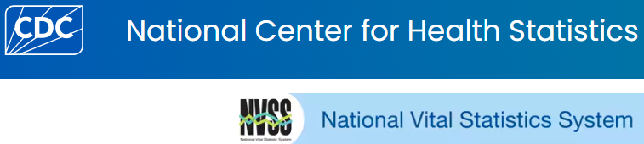
Dataset 1: mental health care in the last four weeks.
Published by the Center for Disease Control, the U.S. Census Bureau, in collaboration with five federal agencies including the U.S. Department of Health & Human Services, launched the Household Pulse Survey to produce data on the social and economic impacts. The Household Pulse Survey was designed to gauge the impact of the pandemic on employment status, consumer spending, food security, housing, education disruptions, and dimensions of physical and mental wellness. It was conducted by an internet questionnaire, with invitations to participate sent by email and text message.
Dataset 3: suicide data.
Pulled from CDC WONDER
Center (Wide-ranging Online Data for Epidemiologic Research), a public menu-driven system that holds a variety of public health datasets. We used the mortality data available which is produced by National Center for Health Statistics (NCHS) at the Centers for Disease Control and Prevention (CDC). Mortality information is collected by state registries and provided to the National Vital Statistics System. Data are based on death certificates and the main underlying cause of death. We used the ICD-10 codes specific to suicide. For the dataset we collected, the crude rate in the dataset = number of suicide deaths in a year, divided by the population and multiplied by 100,000.
Dataset 2: drug overdose deaths.
National Vital Statistics System presents counts for drug overdose deaths based on death records received and processed by the National Center for Health Statistics (NCHS) which is a part of CDC. NCHS receives the death records from state vital registration offices through the Vital Statistics Cooperative Program. The counts include deaths occurring within the 50 states as of the date specified.

Slide 6
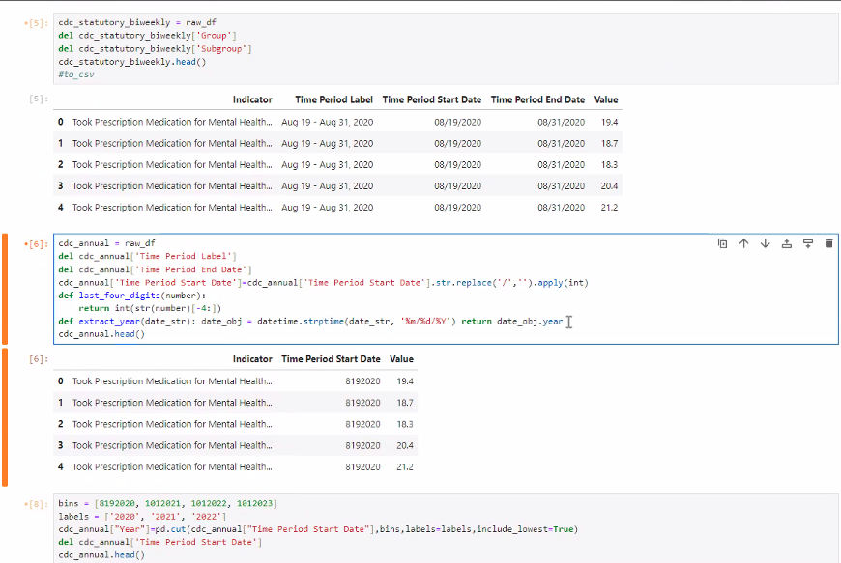
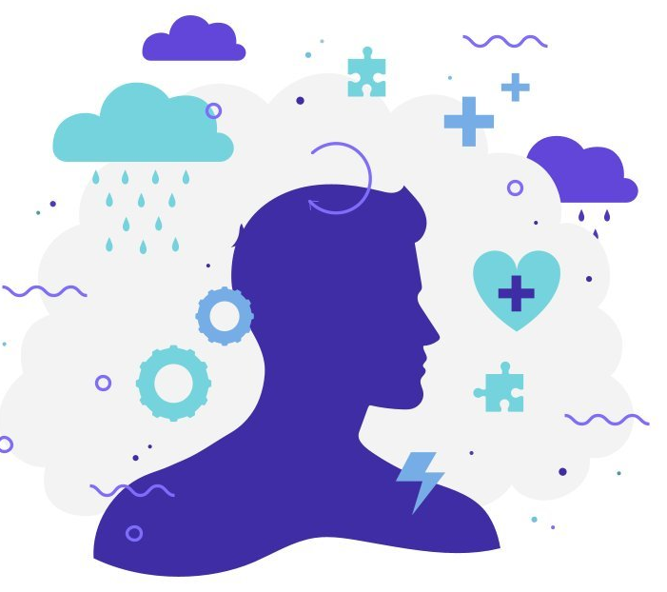
Create Database

Slide 7
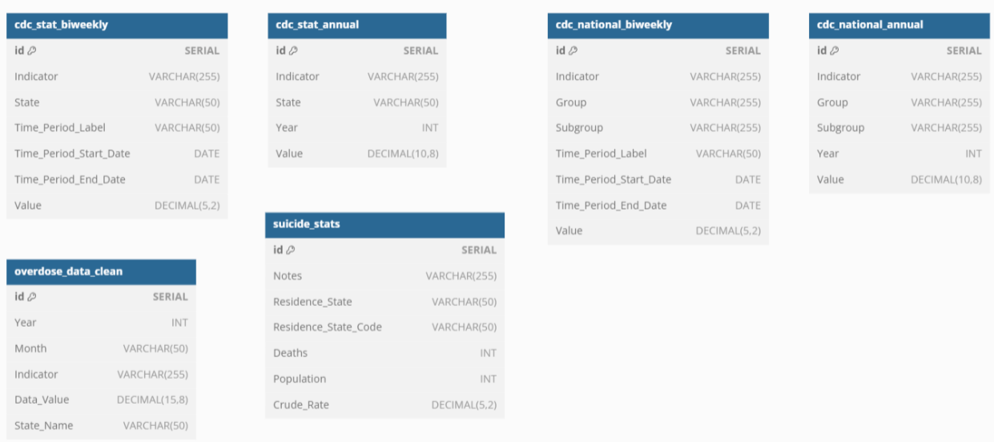
Entity Relationship Diagram (ERD)

Slide 8
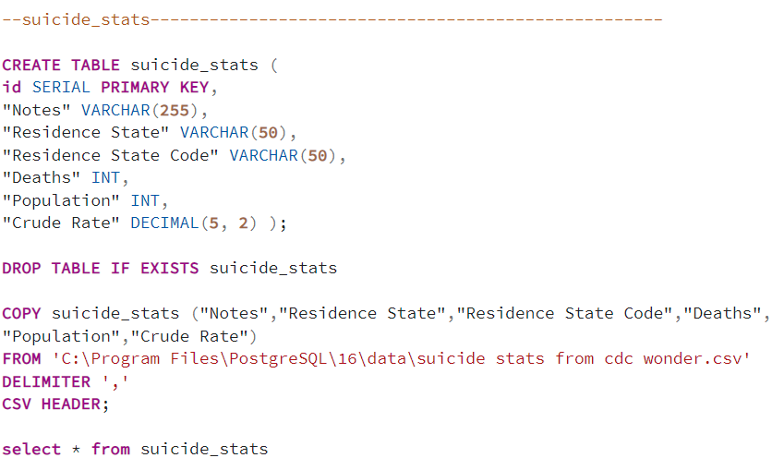
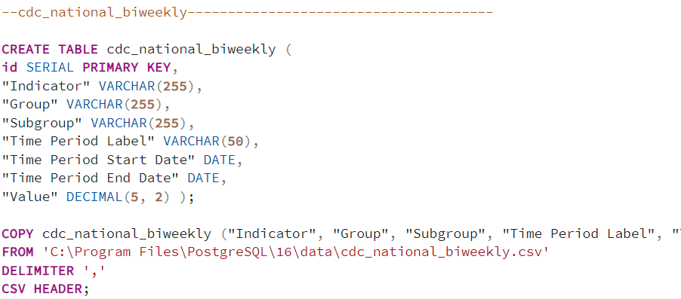


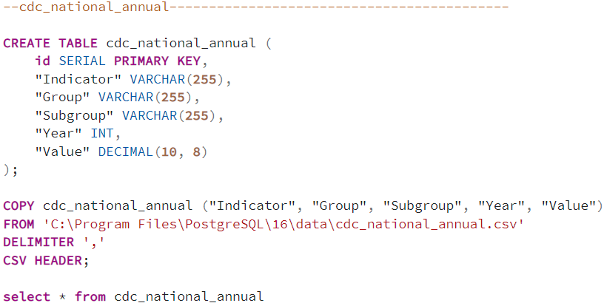
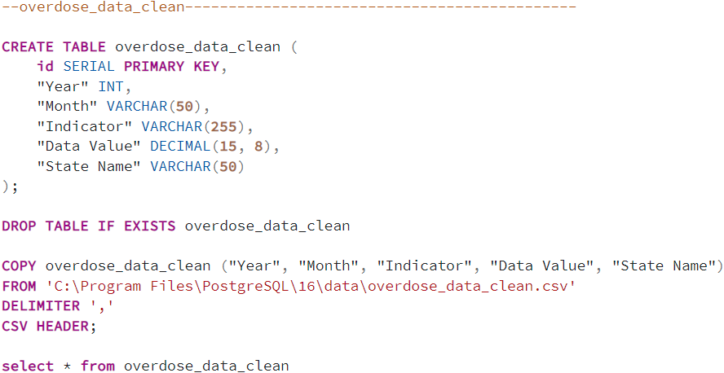
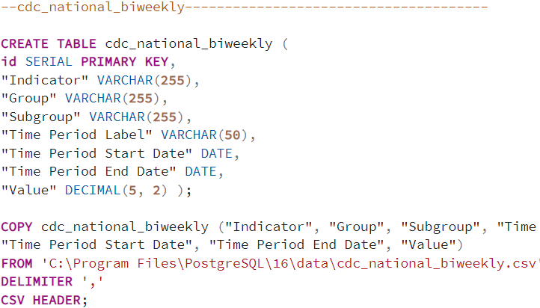

Create tables:

Slide 9
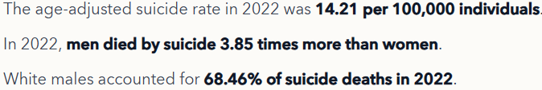
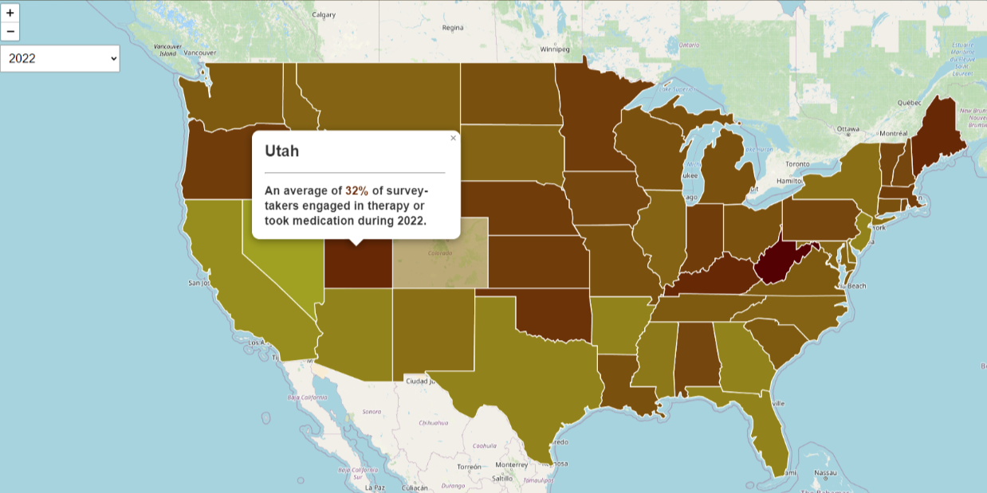

Interactive visuals:
*dropdown for years 2022, 2021, and 2020, defaults to 2020
*coloration of state on a gradient designed by Adam with dark red being the highest numbers
*mouseover adds opacity and state name, mouseout returns color
*clicking on a state adds a popup note shows % of survey takers, with same color as state
*data includes all 50 states and the District of Columbia
https://levifahring.github.io/ku_bootcamp_project3/Project%203/Scripts/us_state_map/index.html

Slide 10
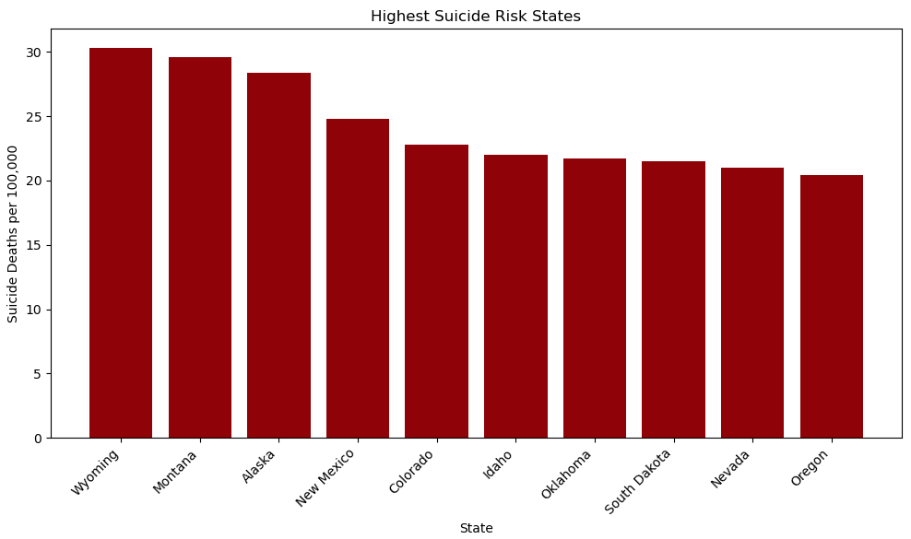

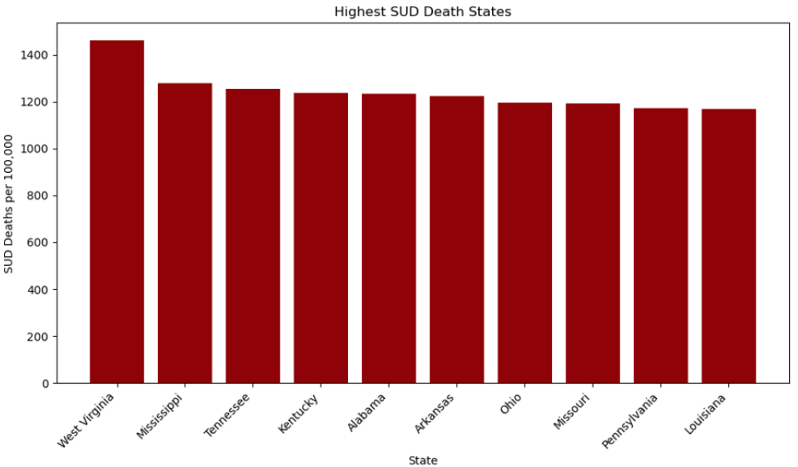
Aggregated the three years of data to determine the ten most at risk states for both suicide and SUD deaths.

Slide 11
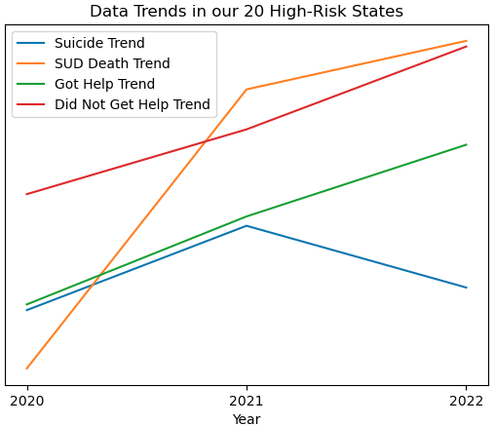

Slide 12
Conclusion
COVID-19 pandemic had a clear negative impact on mental health, suicide, and substance use
In periods of state or national emergency, additional resources need to be allocated to support people who are experiencing these issues particularly if those emergencies persist
The core at risk states include; Wyoming, Montana, Alaska, New Mexico, Colorado, Idaho, Oklahoma, South Dakota, Nevada, Oregon, West, Virginia, Mississippi, Tennessee, Kentucky, Alabama, Arkansas, Ohio, Missouri, Pennsylvania, Louisiana
Investments in rural states will yield a much greater impact as these are the most at-need states

Slide 13

THANK YOU!
Questions?

